Slide 1
Quick brief
Helena Lim

Slide 2
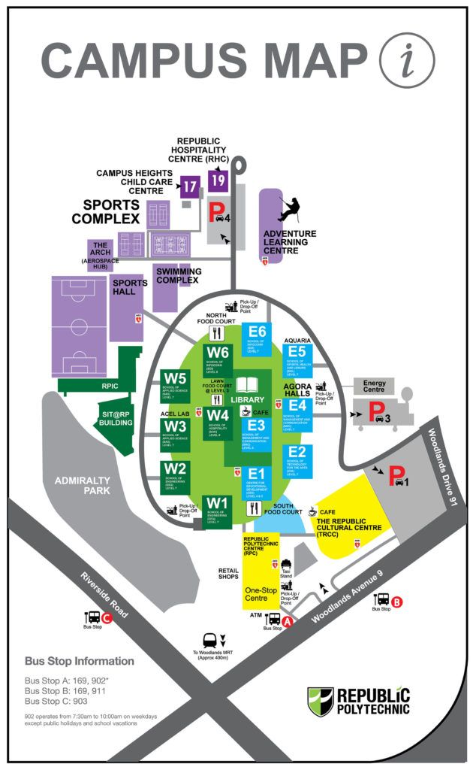
RP Map

Slide 3
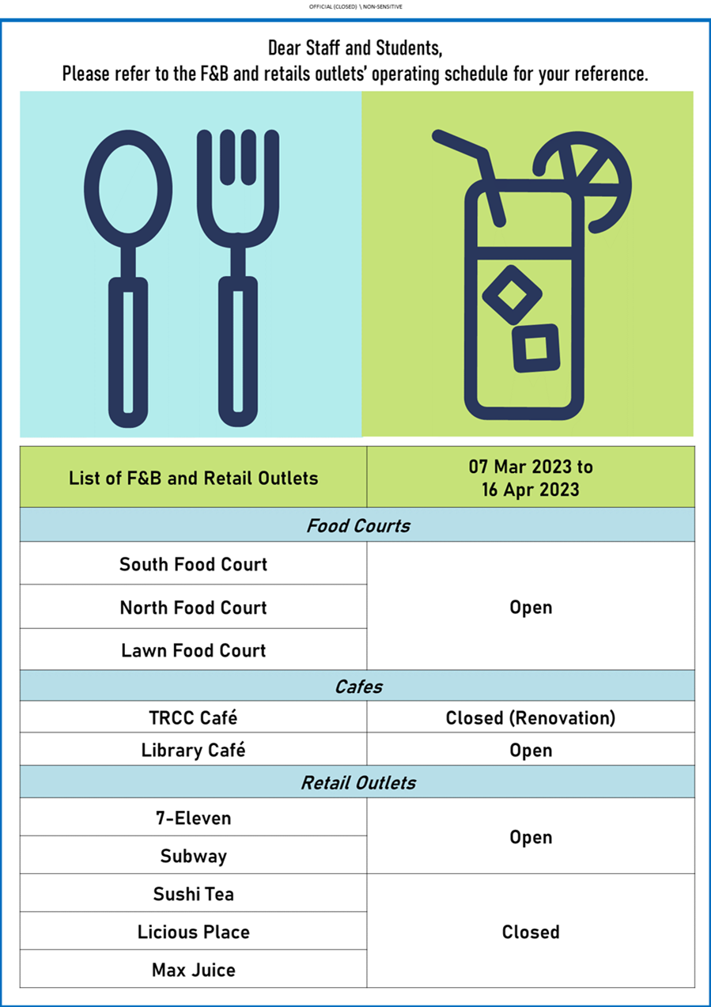

Slide 4



Emergency Evacuation
Stop: what you are doing on hearing the 1st alarm. Wait for further instructions /2nd alarm
Act: At the 2nd alarm, evacuate the building by the nearest exit staircase
Find: Your designated assembly area 4
Do not re-enter the building. Do not use lifts during evacuation.
Emergency Contact Nos: 66971515 (RP Fire Command Centre)

